Slide 1

A Natural Language Processing Framework for Training a Neural Network Chatbot
Group Members: Kamila Michel & Maciej Majchrzak
Supervisor: Gerard Harrison

Slide 2
Overview
Project Overview.
System Design.
System Evaluation / Testing.
Conclusion.

Slide 3
Project Overview
Background Context:
To develop chatbot which could be trained on a given data set.
Testing of smart assistants - Google AIY Kit.
Natural Language Processing.
Goals / Objectives:
Main Goal
To learn more about modern researched technologies such as Artificial Intelligence, Machine Learning, Natural Language Processing, Neural Networks and how they can be used to create chatbot.

Slide 4

Project Overview Continued…
Goal / Objectives:
Objectives:
Research modern technologies.
Creation of simple demo programs for each of the technologies and test how they function.
Practice and test on Natural Language Toolkit to learn about how text can be processed.
Configure and test Google AIY Kit chatbot to tailor it for our purposes.
Integrate previously created demos into chatbot.
Make chatbot client-sever based.

Slide 5
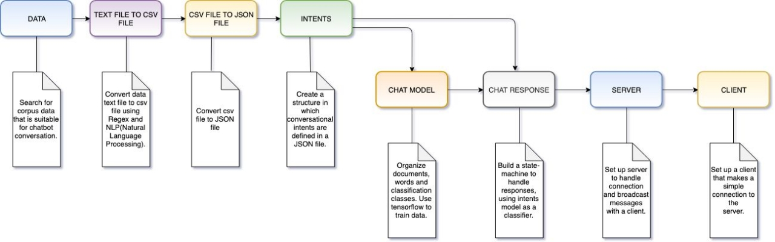
System Design

Slide 6
System Evaluation / Testing
Black Box Testing
Getting friends and family to test out or chatbot application.
White Box Testing
One would develop a feature other would test it.
Example, I developed server-client connection while Kamila tested it.
Limitations
Chatbot is only able to respond to inputs that it was trained on.
Lack of required data for training.
Heavy in term of memory when it comes to training.

Slide 7
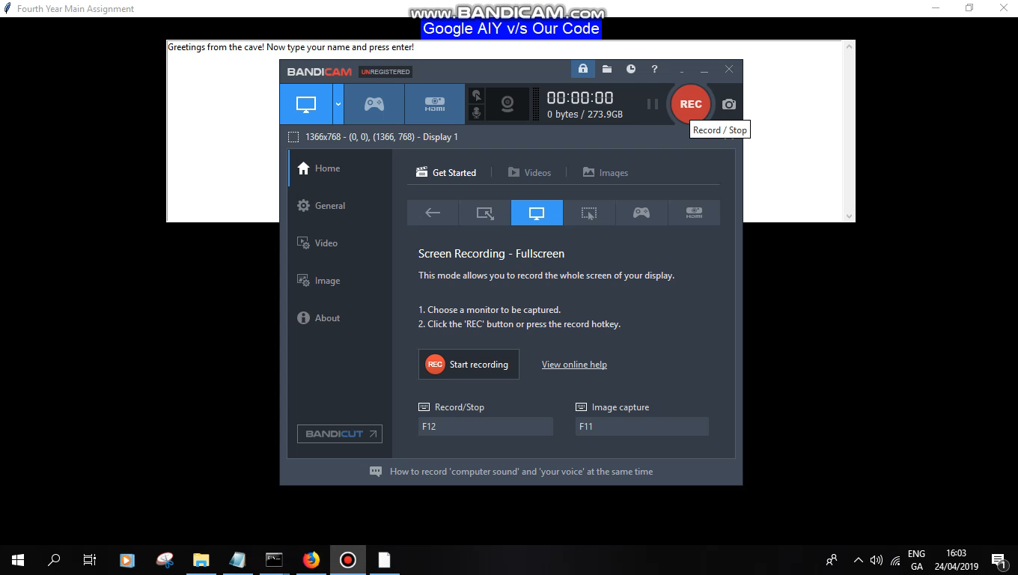
System Evaluation / Testing Continued…

Slide 8
Conclusions
Recommendations / insights?
Lack of documentation about training chatbots with Artificial Intelligence.
Potentially usage for customer service.
Google AIY Kit not well documented.
Dependencies not reliable.
Meeting expected originals goals objectives?
Issues with modification of Google AIY Kit.
Changed project approach.

Slide 9

Questions?

